Slide 1
Yazılım Testi ve Proje Yönetimi
19.02.2024

Slide 2
What is Unified Modeling Language (UML)?
https://www.visual-paradigm.com/guide/uml-unified-modeling-language/what-is-uml/
Overview of the 14 UML Diagram Types
https://www.visual-paradigm.com/guide/uml-unified-modeling-language/overview-of-the-14-uml-diagram-types/

Slide 3
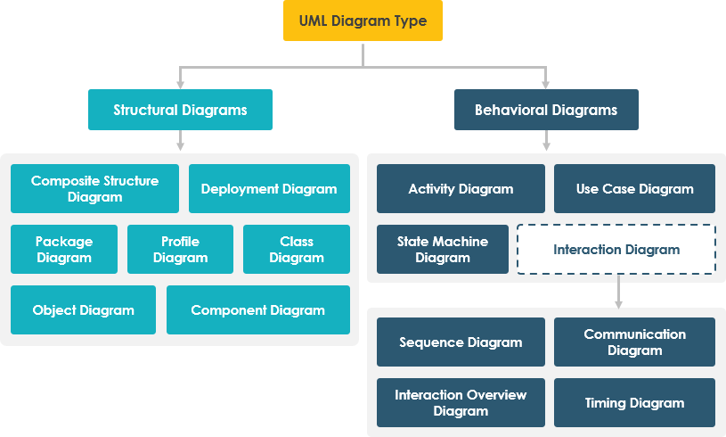

Slide 4
Visual Paradigm Community Edition – A Free UML Tool
What is Use Case Diagram?
https://www.visual-paradigm.com/solution/free-use-case-tool/
What is Sequence Diagram?
https://www.visual-paradigm.com/solution/free-sequence-diagram-tool/

Slide 5
UML Class Diagram Tutorial & How to Write Effective Use Cases?
https://www.visual-paradigm.com/guide/uml-unified-modeling-language/uml-class-diagram-tutorial/
https://www.visual-paradigm.com/tutorials/writingeffectiveusecase.jsp

Slide 6
UML Tool Create UML models in a snap with UML software
https://www.visual-paradigm.com/features/uml-tool/

Slide 7
UML Tutorial: From Problem Description to Models
Textual Analysis is a technique that helps the analyst discover useful model data from a given text
For example: a problem statement, business case, use case description, domain descriptions, legacy model description, and even legacy code.
https://www.visual-paradigm.com/tutorials/from-problem-description-to-models/

