Slide 1
Yazılım Testi ve Proje Yönetimi
26.02.2024

Slide 2
The United Nations Sustainable Development Goals (SDGs)
The United Nations sustainability goals serve as a proxy for human needs.
Engineering of systems will play a central role in addressing the SDGs.
The US National Academy of Engineering (NAE) identified Grand Challenges for Engineering in the 21st Century

Slide 3
Global Megatrends Shape the Systems of the Future
These global socio-economic megatrends shape the needs and expectations for systems, providing products and services across all industries and domains such as transportation, health care, space utilization, communications, energy production and distribution, education, food production, and all forms of modern infrastructure.

Slide 4
Megatrends expected to influence systems engineering through 2035.
Sustainability
Interdependent World
Digital Transformation
Industry 4.0 & Society 5.0
Smart Systems
Complexity Growth

Slide 5
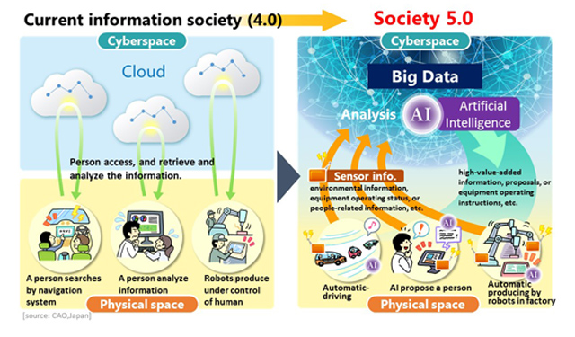
Society 5.0 : Human Centered Society
Balancing economic advancement with the resolution of social problems by a system that highly integrates cyberspace and physical space."

Slide 6
Society 5.0 Balances Economic Development and Solves Social Issues
Japan has established Society 5.0 as a national strategic policy that will shape national priorities and investments.
Society 5.0 is envisioned as society’s next major transformation beyond the information age.

Slide 7
Industry 4.0
Under the Industry 4.0 approach, the logic and control of production changes significantly, and form the basis for smart factories.
Products are monitored, their state of production and shipping are known, and their physical or software state configurations are individually catalogued at every step of their life cycle.
A record for every component of a larger system becomes transparent for customers, manufacturers and supply chains.
Digital twins are at the heart of the overall system development life cycle.
The digital chains of interacting tools and processes are seamless throughout the life cycle.

Slide 8
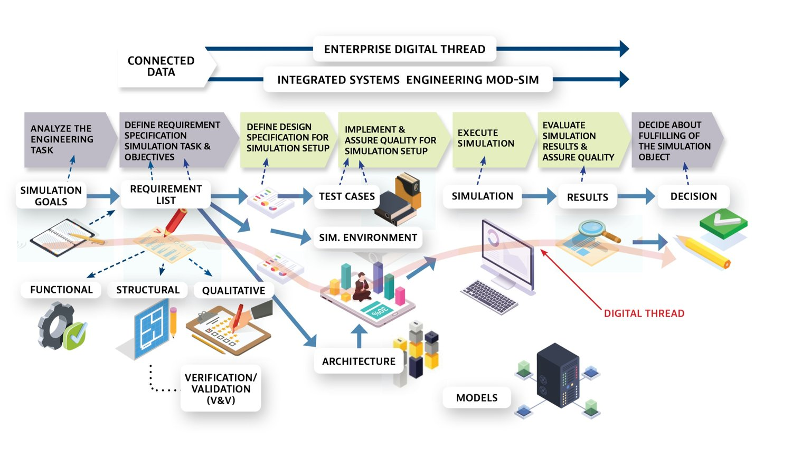
Model-Based Practices The Future of Systems Engineering Is Predominantly Model-Based

Slide 9
Current Model Based Systems Engineering
Growing number of systems engineering organizations have adopted model-based techniques to capture systems engineering work products
But the adoption is uneven across industry sectors and within organizations.
One-off simulations are customly used for each project
and
There is still limited reuse of models especially during critical early phases of systems architecting and design validation.

Slide 10
Model Based Systems Engineering in the Future
Systems engineers routinely compose task-specific virtual models using ontologically linked, digital twin-based model-assets.
These connected models are updated in real-time providing a virtual reality-based, immersive design and exploration space.
This virtual global collaboration space is cloud- based, enabled by modelling as a service and supports massive simulation leveraging cloud-based high-capacity compute infrastructure.
Families of unified ModSim* (Modeling and Simulating) frameworks exist enabling small and medium businesses along with Government agencies to collaborate.
*ModSim: Unified Modeling & Simulation A New Standard for High-Speed Innovation

Slide 11
Impacts of The Digital Transformation The Importance of Robust and Agile Design Process

Slide 12
Impacts of AI on Systems Engineering

